Slide 1
FACIAL TISSUES Group No 3
Ajinkya Rane Mohit Shah
Darshil Sanghvi Sanskruti Jain
Divya Chandramohan Yung-Kuei Chen

Slide 2
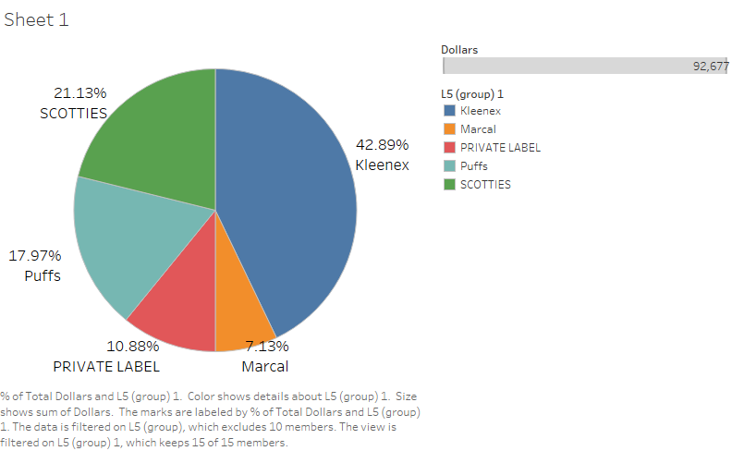
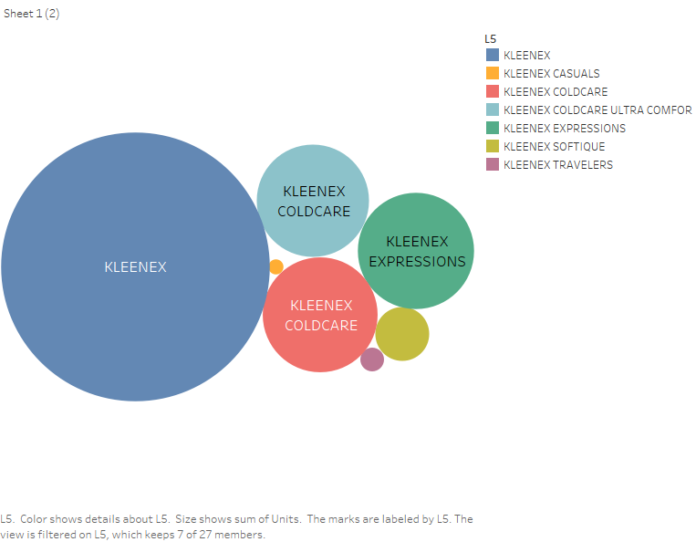
Kleenex is the market leader in the facial tissue category

Slide 3
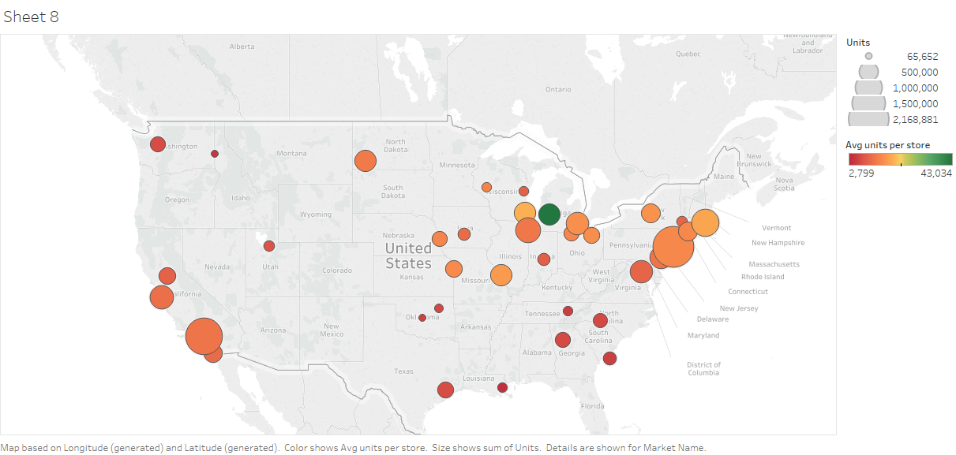
Store performance across cities were mapped to identify best and worst regions
Average units sold per store in a city
Top 3
1- Grand Rapids
2- Boston
3- Milwaukee
Bottom 3
1- New Orleans
2- Spokane
3- Knoxville
Notes:
How presentation will benefit audience: Adult learners are more interested in a subject if they know how or why it is important to them.
Presenter’s level of expertise in the subject: Briefly state your credentials in this area, or explain why participants should listen to you.

Slide 4
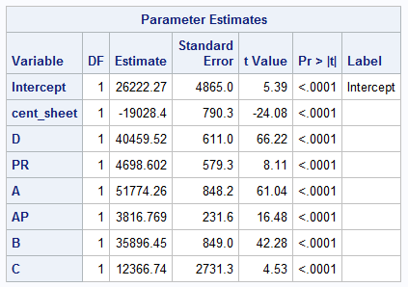
Panel regression was performed to understand the factors effecting units sold
Insights
As cent per sheet value increases by one cent, total sheet sold will decrease by approx. 19000.
In a feature variable, we consider no feature as a base level. A large size ad (Feature A) is most effective. If that particular kleenex brand has a large display then it will sell approx. 51000 sheet more.
Retailer coupon or rebate is least effective feature type, which suggest that people tend to use less coupons for purchase
Order of feature effectiveness
A>B>C>A+

Slide 5
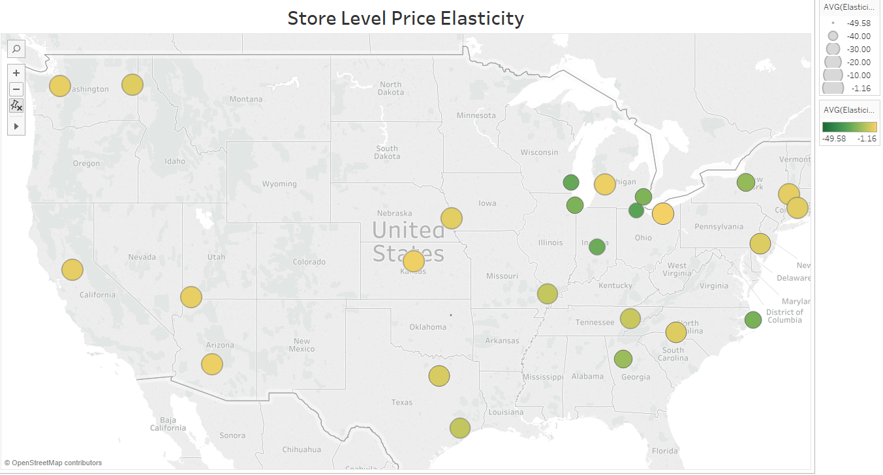
Mid western states are more sensitive to price changes compared to other regions

Slide 6
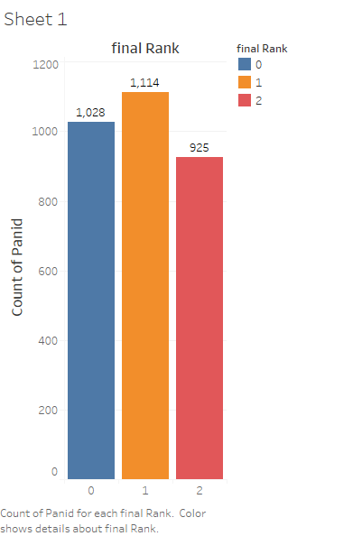
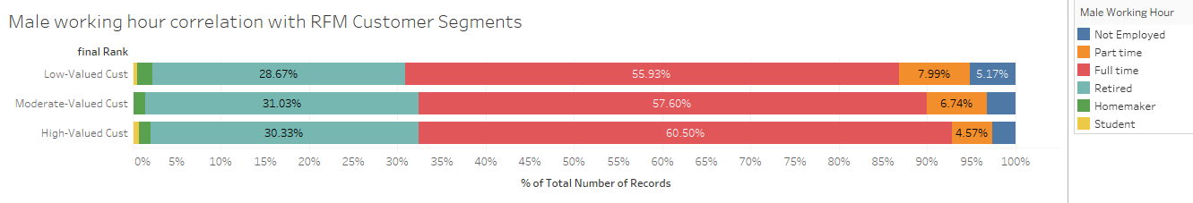
Customers were segmented into high, low, and medium based on value generated
Notes:
Example objectives
At the end of this lesson, you will be able to:
Save files to the team Web server.
Move files to different locations on the team Web server.
Share files on the team Web server.

Slide 7
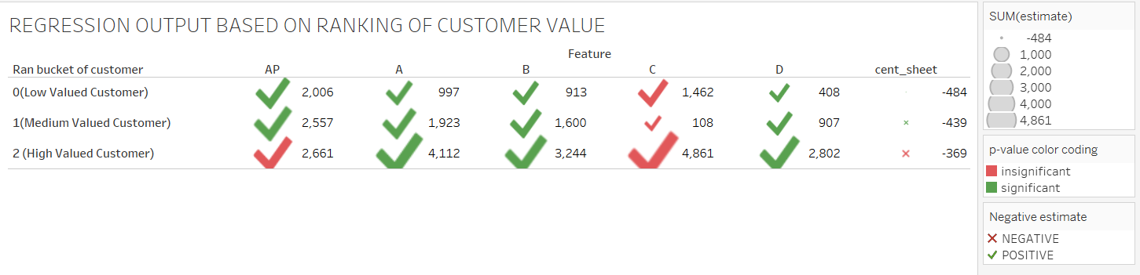
The type of Feature used plays an important role in customer behavior
Insights
"c” Feature has no effect on units of facial tissue sold
The price sensitivity increases as the value of customers decrease (Lo>Med>HI)
Recommendation
Focus should be on A features to draw the attention of medium valued customer instead of investing on low valued features as it has no effect.
Notes:
Example objectives
At the end of this lesson, you will be able to:
Save files to the team Web server.
Move files to different locations on the team Web server.
Share files on the team Web server.

Slide 8
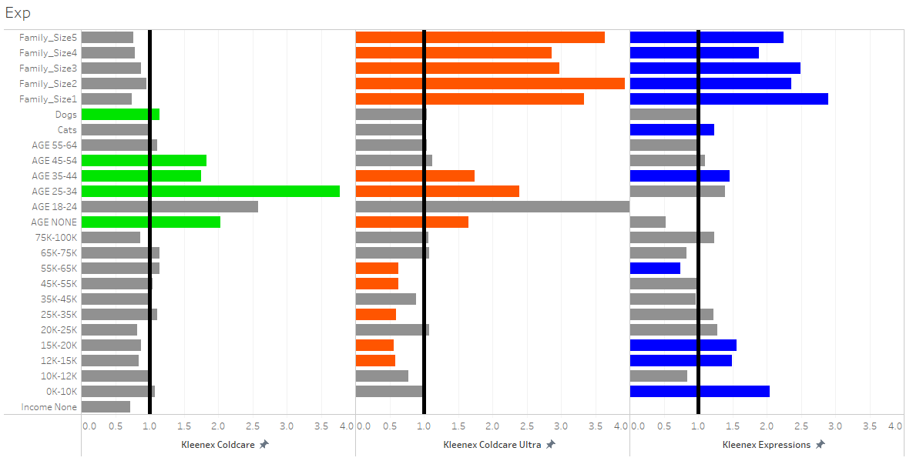
Age, family size and pet ownership have the most impact of customer brand preference
Reference Brand:
Kleenex
Reference group:
Family_size:6+
AGE: 65+
Income:100K+
Insights
Kleenex Coldcare: Young people, Dog owner
Kleenex Coldcare Ultra: Small family, Young people
Kleenex Expressions: Small family, Cat owner
Grey- insignificant variables
Colored- Significant variables

Slide 9


